Slide 1
Simple machines
By Natalie Rowland
And
Caroline Ward

Slide 2
A Few Things you need to know…
Q: What is IMA?
A: Ideal Mechanical Advantage
Q: De and Dr?
A: Distance Effort and Distance Resistance
Q: Fe and Fr?
A: Force Effort and Force Resistance

Slide 3
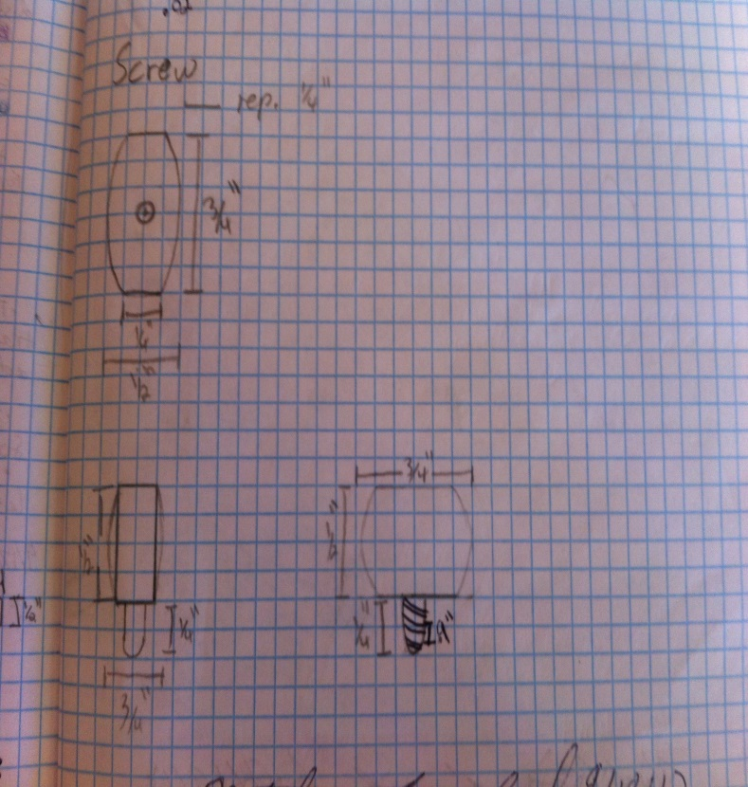
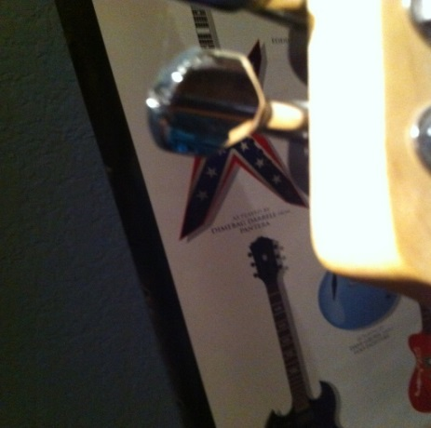
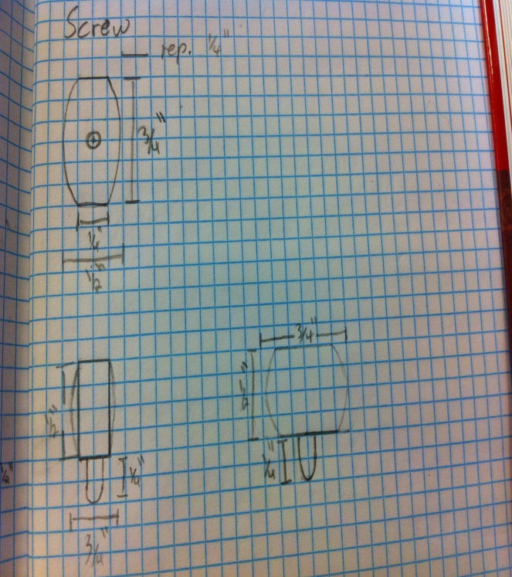
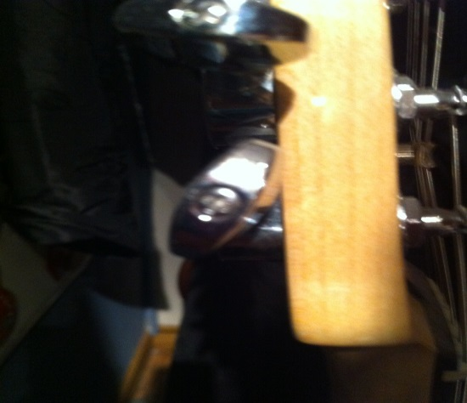
Screw
$$IMA= \frac{Circumference}{Pitch}$$
$$IMA=21.195$$
$$IMA= \frac{2.355in}{\frac{1}{9} in}$$
$$IMA=21.195$$
The tuning key is used to tighten or loosen strings, which is possible without the key, but would be like trying to push open a door inwards when people are going outwards.

Slide 4
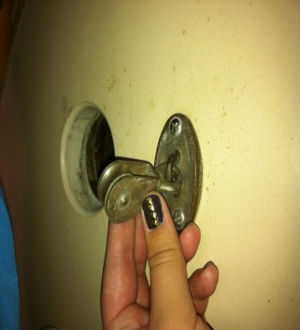
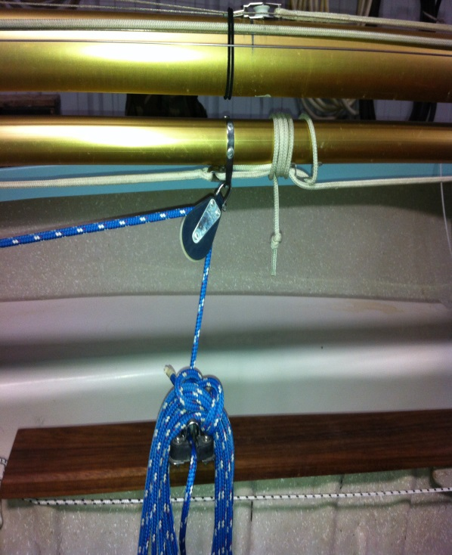
Pulley
$$IMA=8$$
$$IMA=2 ∗2 ∗2$$
$$IMA=8$$
The pulley’s on this sail boat are used to move the boon, which unless conditions were perfect would be impossible to do by hand. It’s like a toddler moving a VW bug compared to a toy car.

Slide 5
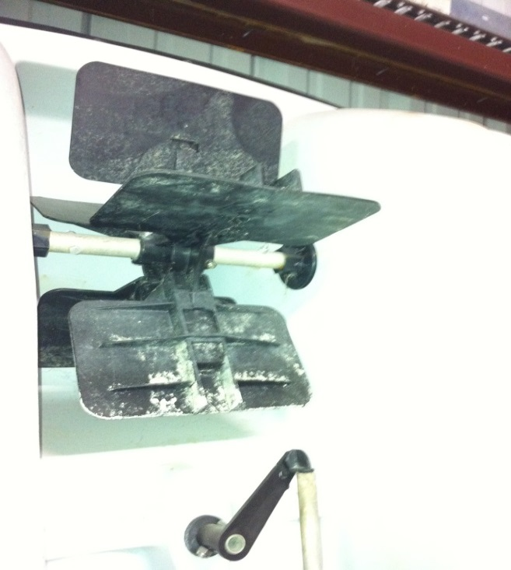
Wheel & Axle
$$IMA=6$$
$$IMA=\frac{D_{E}}{D_{R}}$$
$$IMA= \frac{12in}{2in}$$
$$IMA=6$$
The wheel & axle is used to turn things with less effort to the person, or engine in this case. It’s like spinning a top versus spinning a test book on a table. The top spins more than the book.

Slide 6
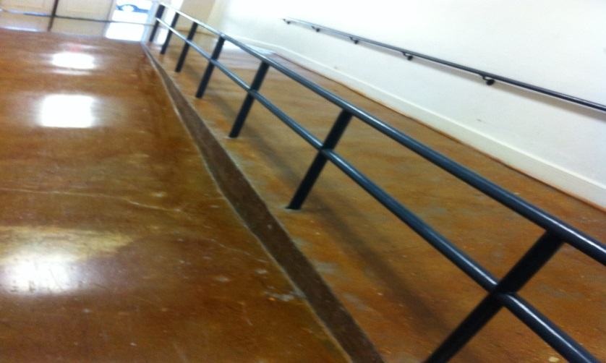
Inclined Plane
$IMA=13.75 VS.$ 21
Left Ramp
Right Ramp
$$IMA= \frac{D_{E}}{D_{R}}$$
$$IMA= \frac{D_{E}}{D_{R}}$$
$$IMA= \frac{220in}{16in}$$
$$IMA= \frac{336in}{16in}$$
$$IMA=13.75$$
$$IMA=21$$

Slide 7
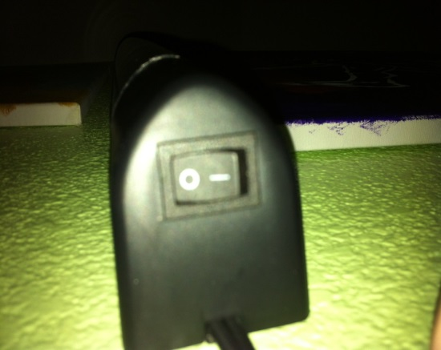
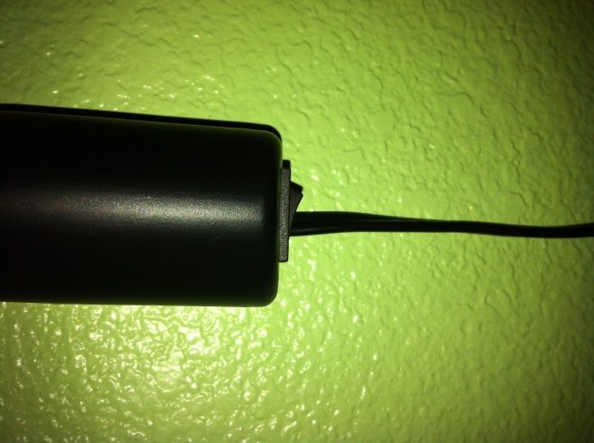
1st Class Lever
$$IMA=10$$
$$IMA=\frac{Fd}{Fd}$$
$$IMA=\frac{.375in(1lb)}{.375in(.1lbs)}$$
$$IMA=10$$

Slide 8
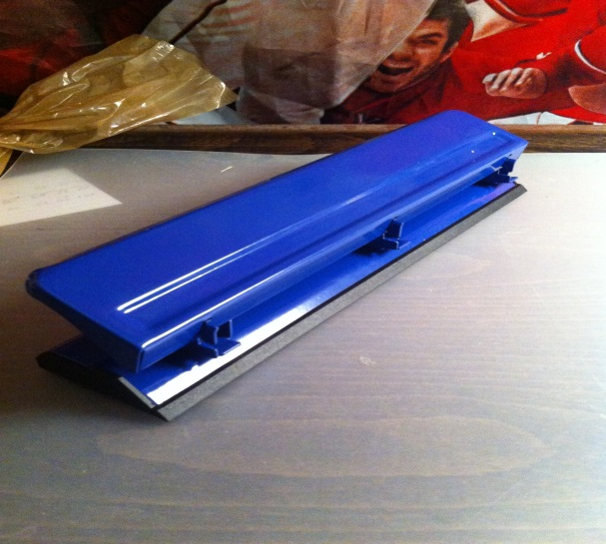
And our Compound Machine…
THE HOLE PUNCHER!!!

Slide 9
3rd Class Lever
$$IMA=5.22$$

Slide 10
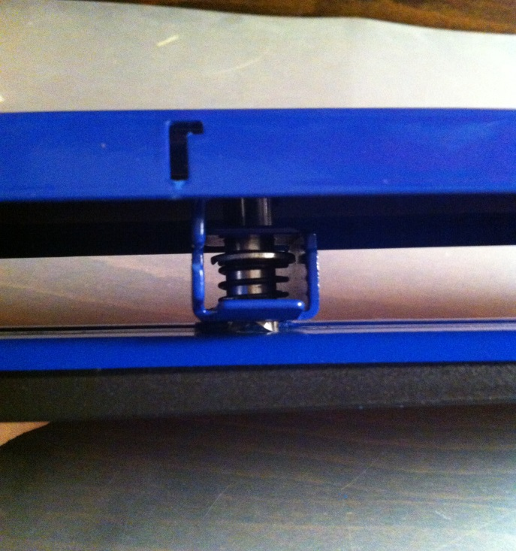
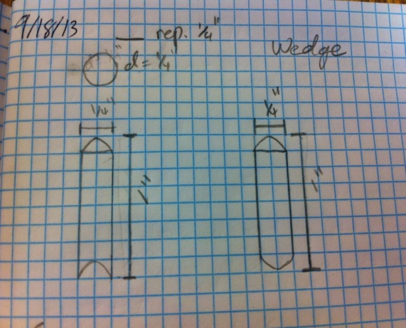
Wedge
$$IMA=3.125$$
$$IMA= \frac{D_{E}}{D_{R}}$$
$$IMA= \frac{.125in}{.04in}$$
$$IMA=3.125$$

